Slide 1

PRICE PREDICTION FOR APARTMENTS

Slide 2
Problem Statement
Buying or selling an apartment is a big decision, and knowing the right price can make a huge difference. It's well known that house prices depend on many factors such as location, size, number of rooms, nearby facilities, etc. Therefore, buyers, sellers, and investors make better choices if house prices are predicted accurately.
Objective
The objective is to develop a predictive model that estimates the prices of apartments based on a set of features such as size, location, number of BHK, society, etc.

Slide 3
Data Overview
S No | Feature Name | Data Type
1 | Description | Object
2 | Location | Object
3 | Transaction | Object
4 | Furnishing | Object
5 | Facing | Object
6 | Overlooking | Object
7 | Society | Object
8 | Bathroom | Int64
9 | Balcony | Int64
10 | Ownership | Object
11 | BHK | Int64
12 | Amount | Float64
13 | Area | Float64
14 | Type of Car Parking | Object
15 | No of Car Parking | Int64
16 | Sale Floor | Int64
17 | Total Floors | Int64
The dataset was taken from the Kaggle. It was originally scraped from the “MagicBricks” website. Dataset link: https://www.kaggle.com/datasets/juhibhojani/house-price/data
The dataset includes the following features:
Description: It is a test-based column, it describes the apartment in a paragraph.
Location: It gives the city where the apartment is located.
Transaction: A categorical feature that gives the different transaction types. It has three categories in the dataset: Resale, New Property, and Other, where Other consists of all the other Transaction types since they are in the minority.
Furnishing: It gives the type of furnishing of the apartment. Unfurnished, Furnished or Semi-Furnished.
Facing: It gives the direction where the flat is facing. It is also a categorical column.
Overlooking: It gives the overlook that the flat provides. It is also a categorical column.
Society: Every apartment is either a part of society/community or is not a part of society. This feature provides the name of the Society the flat belongs to. If the flat is not a part of society, then it is a Standalone Building.
Bathroom: It gives the count of Bathroom in the flat up to 10.

Slide 4
Data Overview Cont.
Balcony: It gives the count of Balcony in the flat up to 10.
Ownership: It gives the ownership types for the flats. They are Freehold, Leasehold, Co-operative Society, and Power of Attorney.
BHK: It gives the count of BHK in the flat up to 10.
Amount: It gives the price of the flat to buy. It is in Lakhs.
Area: It gives the area that the flat covers.
Type of Car Parking: It gives the type of Car Parking spot the flat provides. Either Open or Covered. If not provided, then it is represented by “Not_Available”.
No of Car Parking: It gives the count of Car Parking spots provided by the flat.
Sale Floor: It gives the floor number that is being sold. Here, -2 means lower basement, -1 means upper basement, 0 means Ground floor and other values start from 1 up to 200.
Total Floors: It gives the total number of floors in the building in which a flat is being bought.

Slide 5
Pre-Processing
For the project, the following preprocessing steps were performed:
Handling the duplicates: Dropped the duplicates, there were almost 64% of duplicates.
Non-Essential Features: Removed features that did not give any information.
Handling Corrupted data: There were a lot of corrupted data that needed to be cleaned.
Handling Missing Values: Dropped the missing values to maintain the integrity of core values, as the dataset was large enough.
Handling outliers: Almost all the numerical columns had outliers. Removed 4 extreme outliers of target column, and imputed the outlier of the “Area” column.
OrdinalEncoder & RobustScaler: OrdinalEncoder was used to encode categorical columns and RobustScaler was used to scale numerical features.

Slide 6
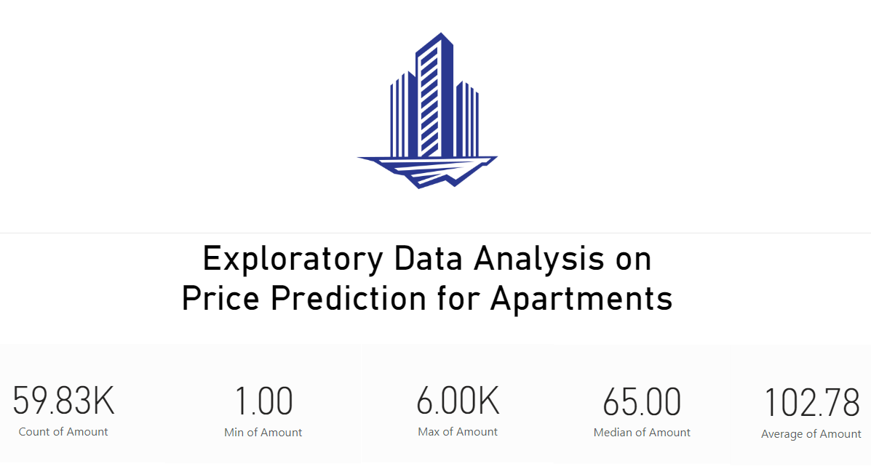
Exploratory Data Analysis (EDA)

Slide 7
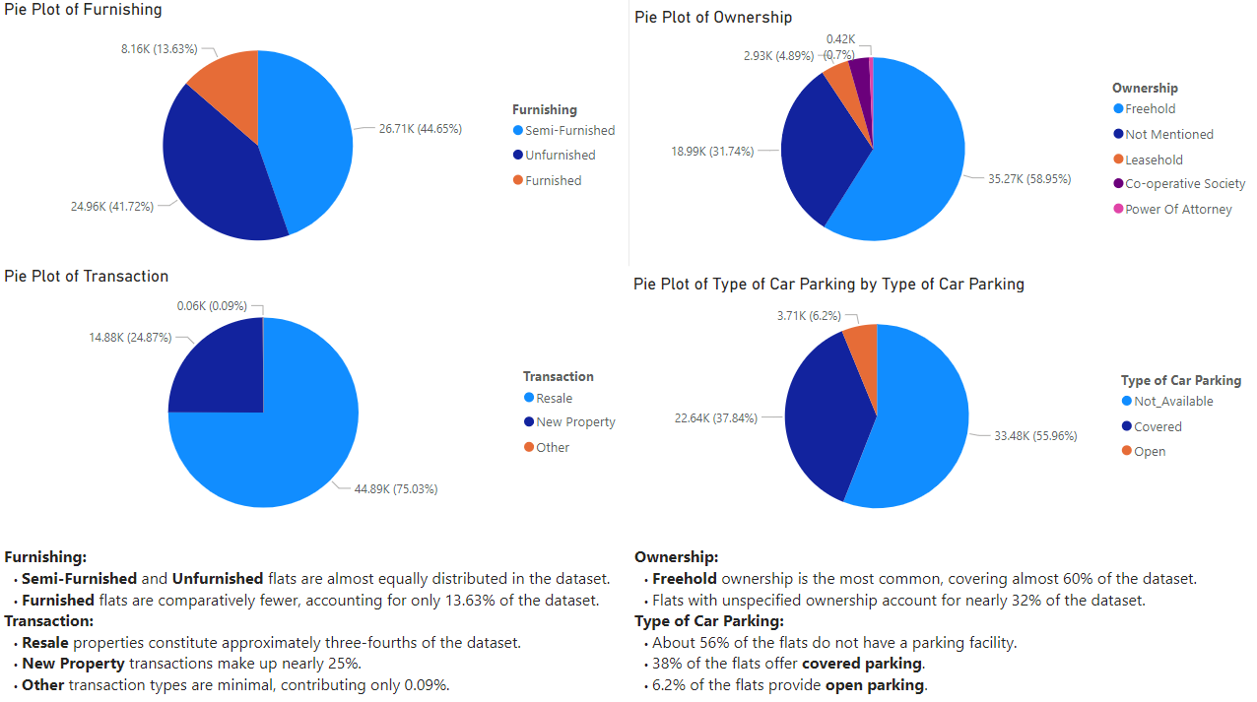
EDA (Cont.):

Slide 8
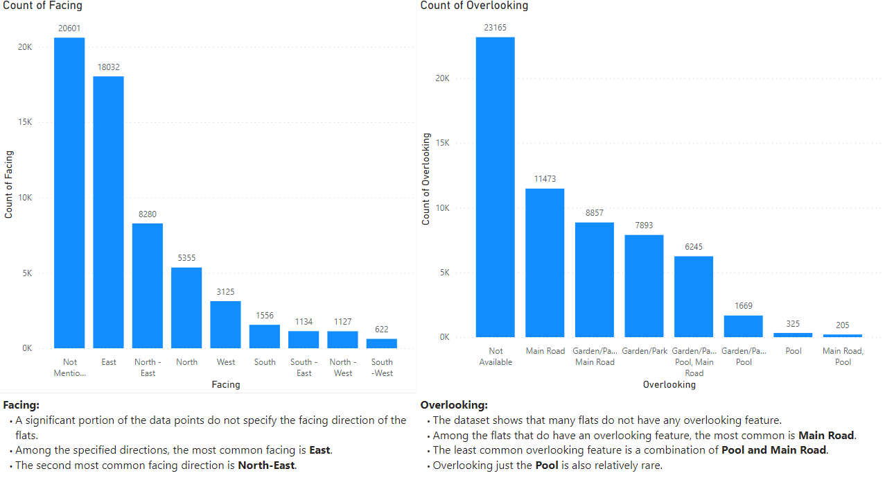

Slide 9
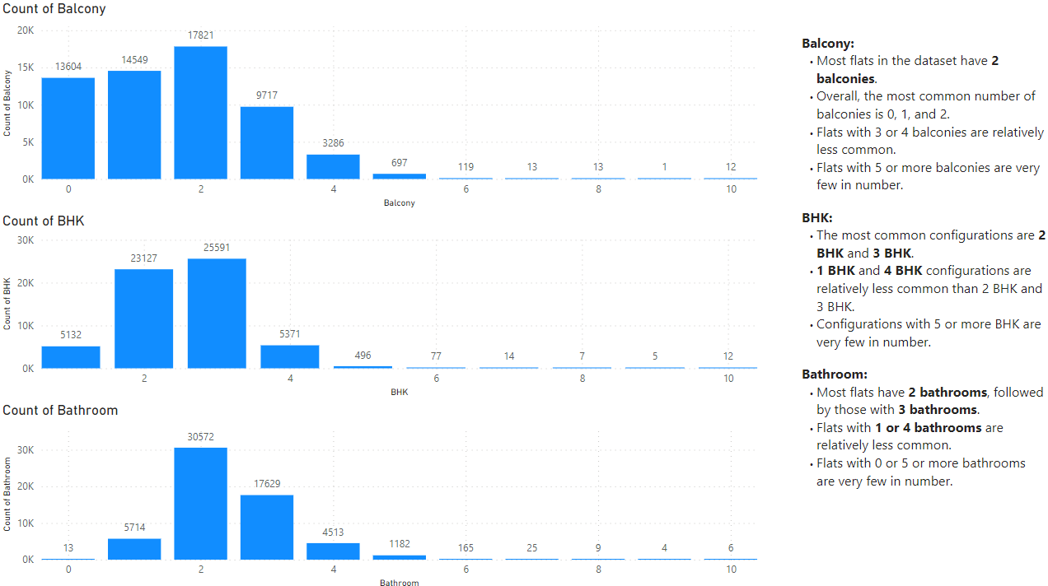

Slide 10
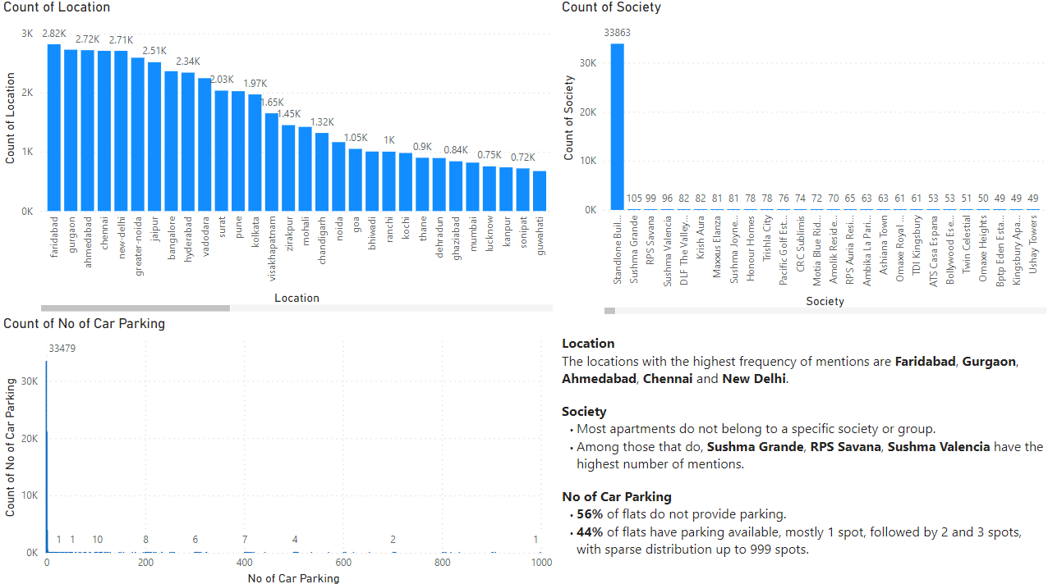

Slide 11
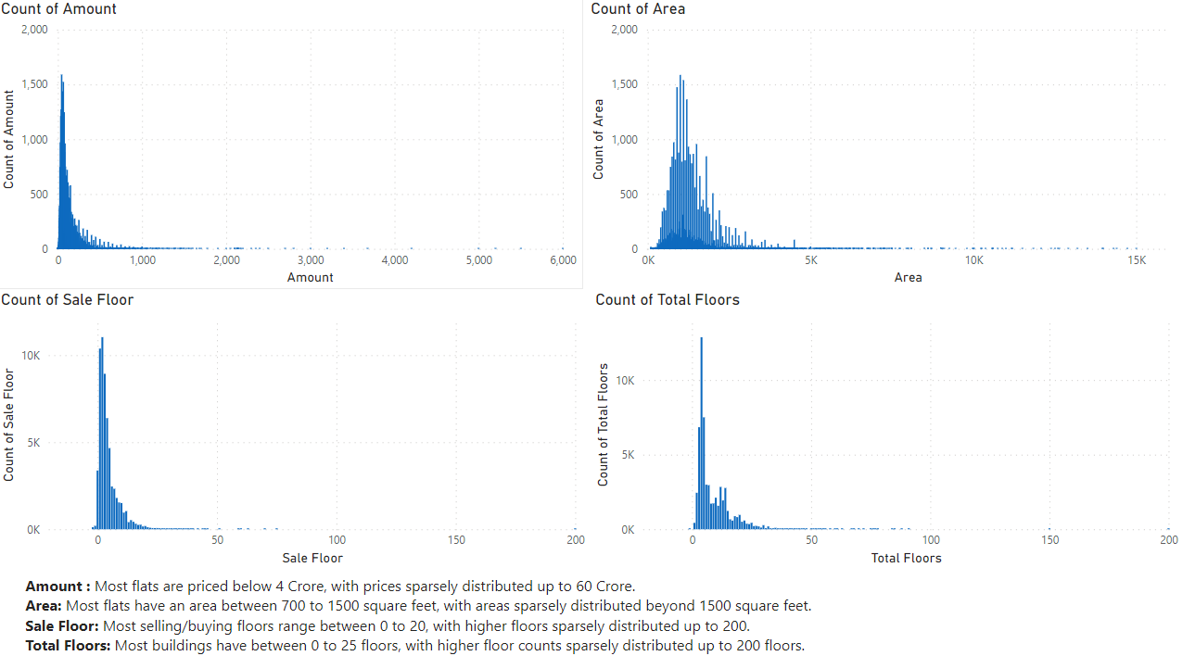

Slide 12
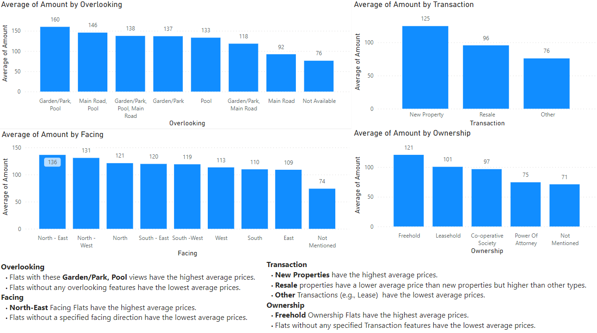

Slide 13
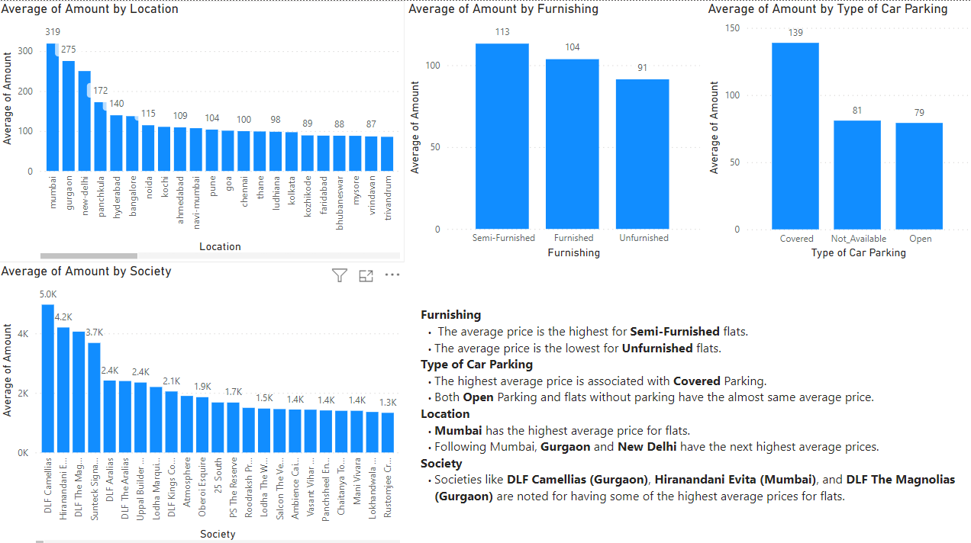

Slide 14
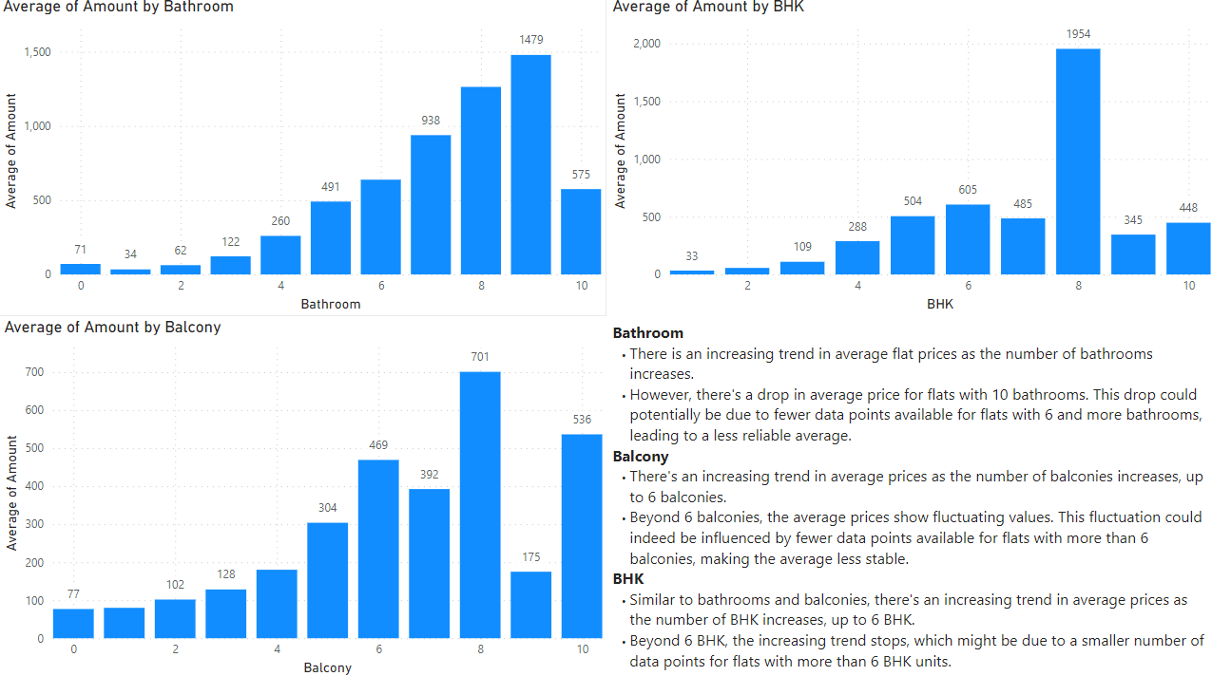

Slide 15
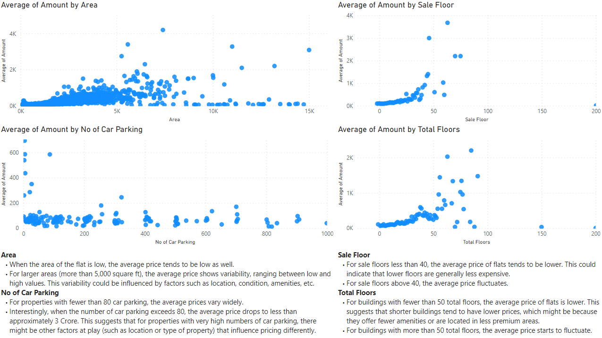

Slide 16
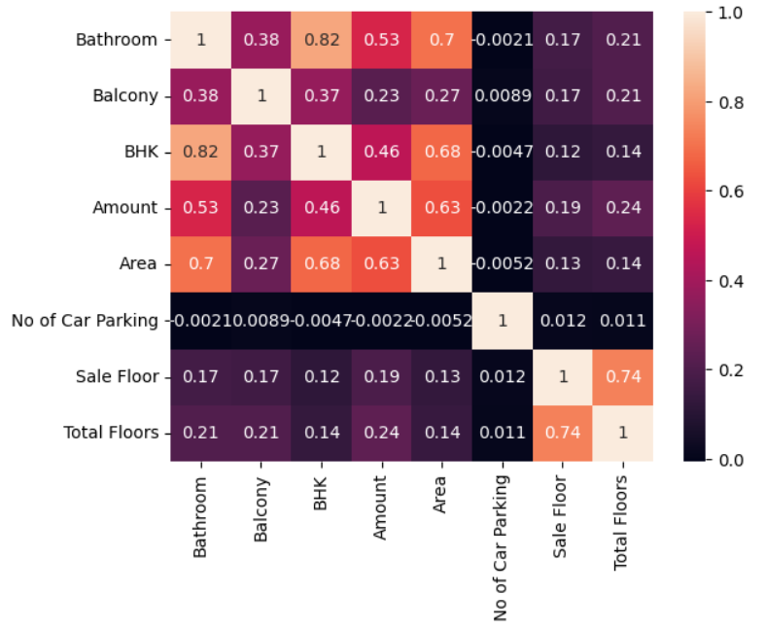
Heatplot
We can observe that,
Bathroom and BHK has the highest correlation of 0.82, which means that the flats with more number of rooms has more number of bathroom.
Area has a good correlation with bathroom, BHK and amount, which means that if the area of the flat is more, the number of bathroom, BHK and amount is also high.
Total Floor and Sale Floor also has a good correlation of 0.74.
Even bathroom and BHK has some correlation with Amount.

Slide 17
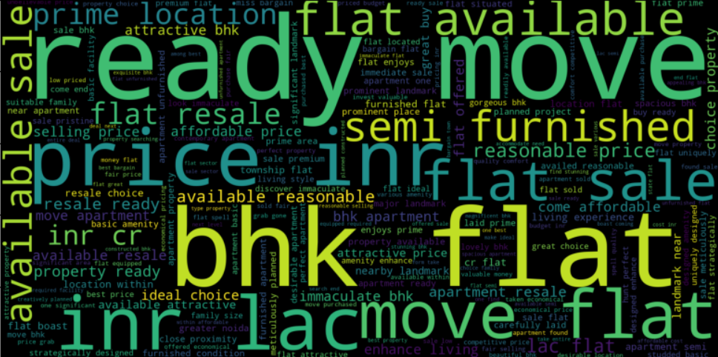
WordCloud
From the above wordcloud, we can see that the words like "attractive"," immaculate" "reasonable, "affordable", "ideal choice", and "proximity", etc. have been used.

Slide 18
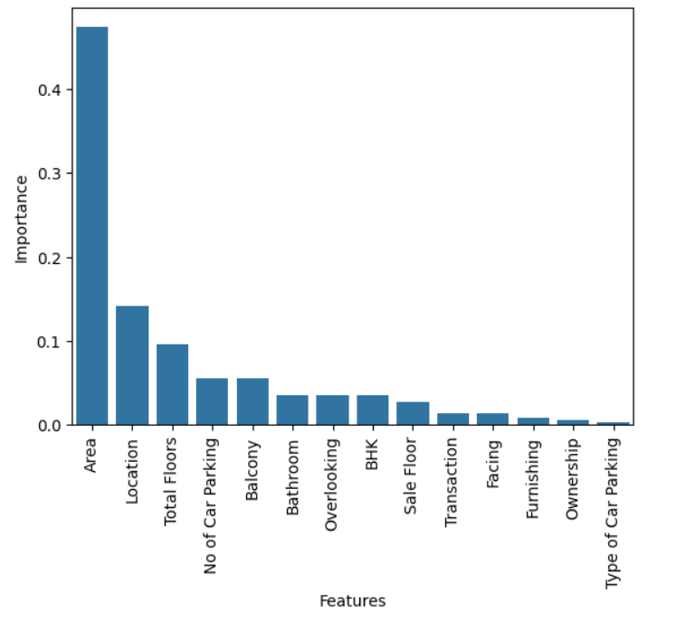
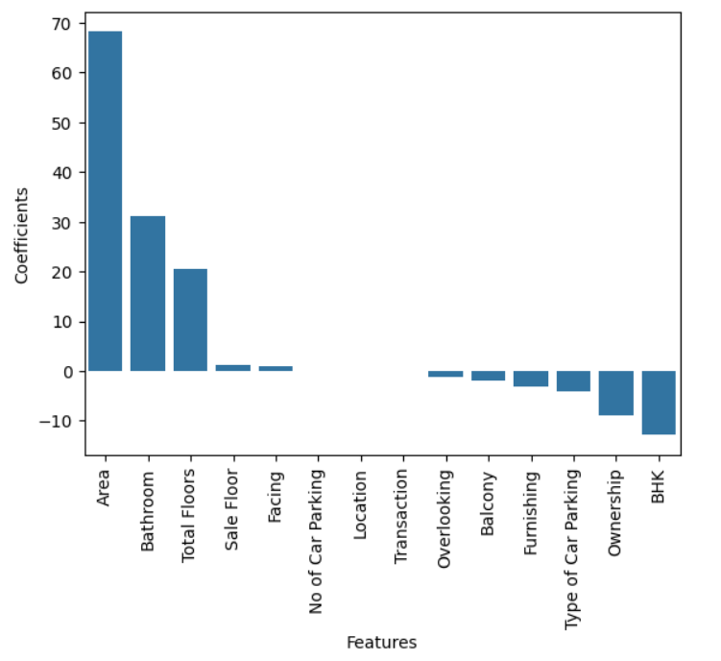
Important features
From the above table we could see that "Area", "Location", "Total Floor" are important features.
We can see that "Area", "Bathroom" and "Total Floors" have higher importance.

Slide 19
Model Building
Splitting the dataset into training and testing sets (85:15 Ratio) to train the models on a subset of the data and evaluate their performance on unseen data.
S No | Type of Problem | Algorithm Name
1 | Regression | KNeighborsRegressor
2 | Regression | LinearRegression
3 | Regression | SVR
4 | Regression | RANSACRegressor
5 | Regression | DecisionTreeRegressor
6 | Regression | GradientBoostingRegressor
7 | Regression | TheilSenRegressor
8 | Regression | HuberRegressor
9 | Regression | RandomForestRegressor
10 | Regression | Ridge
11 | Regression | Lasso
12 | Regression | ElasticNet

Slide 20
Model Training
S No | Algorithm Name | Mean Squared Error | Mean Absolute Error | Root Mean Squared Error | r-squared Error | Adjusted r-squared
1 | DecisionTreeRegressor | 2.383506 | 0.130467 | 1.543861 | 0.999892 | 0.999892
2 | KNeighborsRegressor | 4987.383825 | 25.241719 | 70.621412 | 0.774589 | 0.774237
3 | SVR | 18327.461727 | 48.400631 | 135.378956 | 0.171668 | 0.170374
4 | LinearRegression | 12415.385237 | 51.247661 | 111.424348 | 0.438872 | 0.437995
5 | TheilSenRegressor | 368718.853199 | 76.261571 | 111.424348 | -15.664690 | -15.690729
6 | HuberRegressor | 14152.330738 | 44.175670 | 118.963569 | 0.360368 | 0.359369
7 | RANSACRegressor | 55814.273630 | 67.626729 | 236.250447 | -1.522593 | - 1.526535
8 | GradientBoostingRegressor | 4984.261242 | 32.386188 | 70.599301 | 0.774730 | 0.774378
9 | RandomForestRegressor | 865.017401 | 10.034064 | 29.411178 | 0.960905 | 0.960843
10 | Ridge | 12415.385242 | 51.247456 | 111.424348 | 0.438872 | 0.437995
11 | Lasso | 12441.357490 | 51.064840 | 111.540833 | 0.437698 | 0.436819
12 | ElasticNet | 12998.748277 | 49.840567 | 114.012053 | 0.412506 | 0.411588

Slide 21
Model Evaluation
S No | Algorithm Name | Training Time | Predicting Time | Mean Squared Error | Mean Absolute Error | Root Mean Squared Error | r-squared Error | Adjusted r-squared
1 | DecisionTreeRegressor | 0.582244 | 0.027884 | 8459.977702 | 35.436810 | 91.978137 | 0.604592 | 0.603974
2 | KNeighborsRegressor | 0.192670 | 1.818614 | 6883.298237 | 30.810188 | 82.965645 | 0.678284 | 0.677781
3 | LinearRegression | 0.065665 | 0.004901 | 12801.388275 | 51.397729 | 113.143220 | 0.401680 | 0.400745
4 | HuberRegressor | 3.776718 | 0.002660 | 14098.006126 | 44.182237 | 118.735025 | 0.341077 | 0.340048
5 | GradientBoostingRegressor | 6.611134 | 0.014052 | 7085.551404 | 33.875289 | 84.175717 | 0.668830 | 0.668313
6 | RandomForestRegressor | 28.774948 | 0.385829 | 5556.702941 | 27.343809 | 74.543296 | 0.740287 | 0.739881
7 | Ridge | 0.014071 | 0.002679 | 12801.366993 | 51.397524 | 113.143126 | 0.401681 | 0.400746
8 | Lasso | 0.038083 | 0.004937 | 12797.951208 | 51.243515 | 113.128030 | 0.401840 | 0.400906
9 | ElasticNet | 0.027884 | 0.003003 | 13098.589097 | 49.834915 | 114.449068 | 0.387789 | 0.386832

Slide 22
Conclusion
The best-fit model with less prediction time was Gradient Boosting regression with max_depth=5, min_samples_leaf=5, min_samples_split=6, learning_rate=0.2, loss=” huber”, and alpha=0.75.
This model had the adjusted r-square equal to 0.742769 for training and 0.669193 for testing.
This is the model used for deployment.
Challenges Faced
There was a lot of cleaning required for this dataset. And using cross-validations to find the best fit took a lot of time.

Slide 23
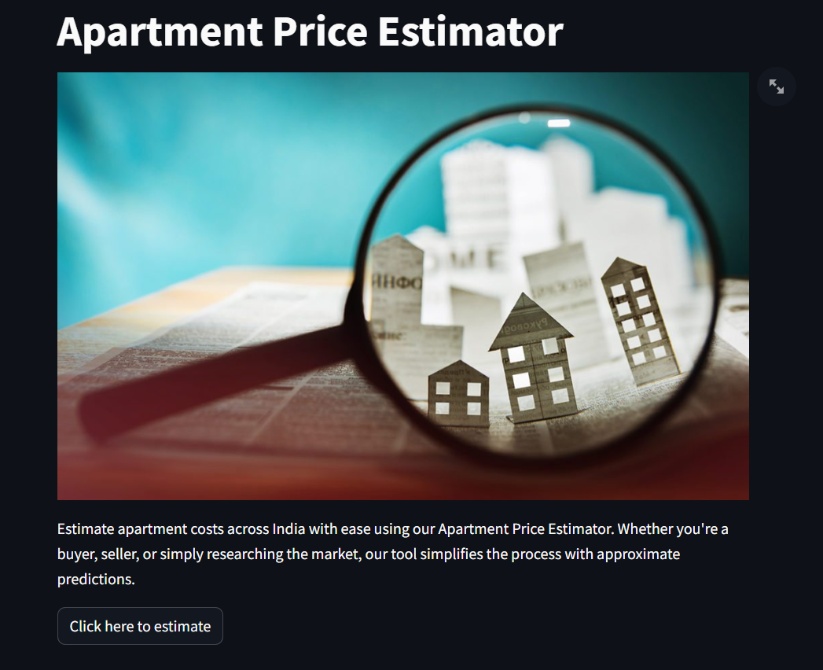
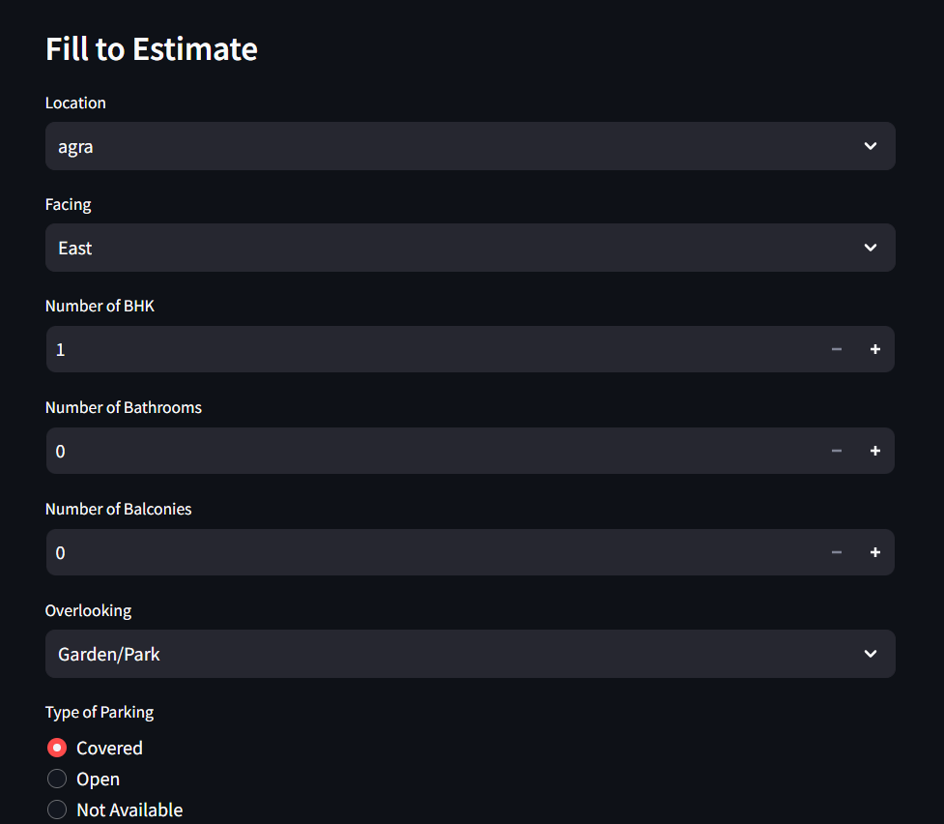
Deployment

